Slide 1

Results Highlights PowerPoint Set UK-VARSS 2021
Published November 2022

Slide 2

UK – VARSS 2021
The following selected PowerPoint slides provide the core for a presentation on antibiotic sales, antibiotic use and antibiotic resistance.
These slides are based on the UK-VARSS 2021 Report which provides further details.
VARSS REPORT 2021
2

Slide 3
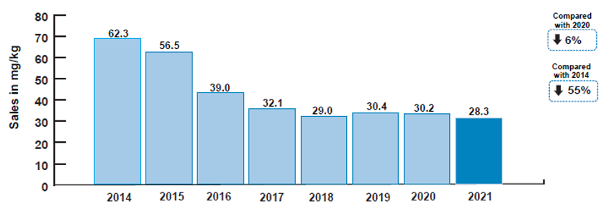
Antibiotic Sales
Sales of veterinary antibiotics for use in food-producing animals, adjusted for animal population, were 28.3 mg/kg in 2021; a 6% (2.0 mg/kg) decrease since 2020 and a 55% (34.0 mg/kg) decrease since 2014. This represents the lowest sales to date.
Active ingredient adjusted for population (mg/kg) of antibiotics sold for use in food-producing animals, 2014 to 2021
© 2022 VMD
© 2022 VMD
Source: p. 7
VARSS REPORT 2021

Slide 4
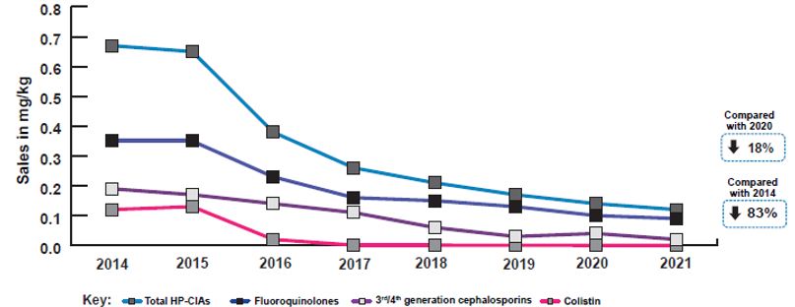
Antibiotic Sales
Sales of Highest Priority Critically Important Antibiotics (HP-CIAs) in food-producing animals, adjusted for animal population, were 0.12 mg/kg in 2021; an 18% (0.02 mg/kg) decrease since 2020 and an 83% (0.6 mg/kg) decrease since 2014. HP-CIAs now represent 0.4% of overall antibiotic sales.
Sales of Highest Priority Critically Important Antibiotics (HP-CIAs) in food-producing animals, 2014 to 2021
© 2022 VMD
© 2022 VMD
Source: p. 7
VARSS REPORT 2021

Slide 5
Antibiotic Sales
Tetracyclines and penicillins were the most sold antibiotic classes. All antibiotic classes decreased between 2020 and 2021 except aminoglycosides and amphenicols, which remained stable.
Active ingredient (mg/kg) of non-HP-CIA antibiotics by antibiotic class sold for use in food-producing animals, 2014 to 2021
© 2022 VMD
© 2022 VMD
*Pleuromutlinins, lincosamides, amphenicols, first and second generation cephalosporins, imidazole derivates, aminocoumarins.
Source: Fig. 1.3; p. 19
VARSS REPORT 2021

Slide 6
Antibiotic Sales
For the first time, oral/water* has overtaken in-feed as the most sold route of administration for food producing animals. Between 2020 and 2021, sales of in-feed products decreased by 20% (2.5 mg/kg) whereas sales of oral/water products decreased to a lesser degree, by 2% (0.2 mg/kg).
Active ingredient (mg/kg) of antibiotics by route of administration sold for use in food-producing animals, 2014 to 2021
© 2022 VMD
*Oral powders, oral pastes, oral solutions, and bolus preparations. ** Includes intramammary dry and lactating cow, and intrauterine preparations
Source: Fig. 1.5; p. 20
VARSS REPORT 2021

Slide 7
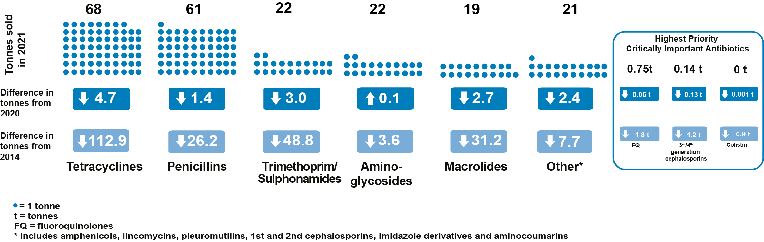
Antibiotic Sales
Total sales (tonnes) of active ingredient for all animal species
by antibiotic class, 2021.
© 2022 VMD
Source: p. 8
VARSS REPORT 2021

Slide 8
Antibiotic Sales
In 2021 the total quantity of antibiotic active ingredient sold in the UK was 212 tonnes, the lowest sales to date.
© 2022 VMD
This is a 14.3 tonne (6%) decrease since 2020, and a 234.2 tonne (52%) decrease since 2014.
Source: p. 7
VARSS REPORT 2021

Slide 9
Antibiotic Sales
Harmonised primary outcome indicators for antibiotic consumption in food-producing animal species in the UK; 2014 to 2021
© 2022 VMD
Source: Fig 1.12; p. 27
VARSS REPORT 2021

Slide 10
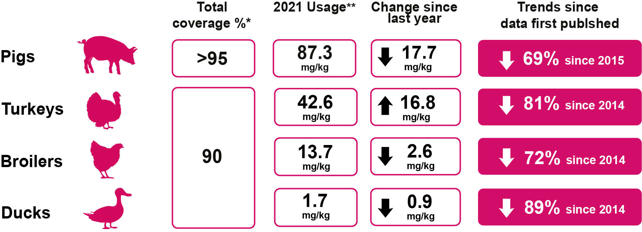
Antibiotic Usage Data
Antibiotic usage refers to the amount of antibiotics prescribed and/or administered per sector. The data have been collected and provided to the VMD by the animal industry on a voluntary basis
© 2022 VMD
* Represents the % animals covered by the data, except gamebirds which represents an estimate of the total % antibiotics sales
** mg/kg relates to the amount of active ingredient standardisedy kg biomass and calculated using ESVAC methodology, % doses
refers to ‘actual daily bird-doses/100 bird-days at risk’
† Note that industry estimates suggest that, due to Covid restrictions, gamebird rearing reduced by 30% during 2020
Source: p. 9
VARSS REPORT 2021

Slide 11
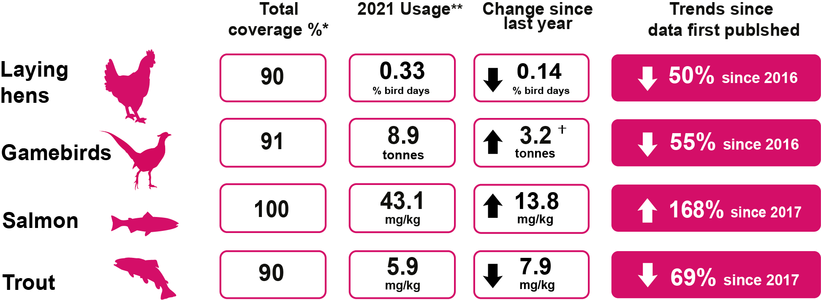
Antibiotic Usage Data
Antibiotic usage refers to the amount of antibiotics prescribed and/or administered per sector. The data have been collected and provided to the VMD by the animal industry on a voluntary basis
© 2022 VMD
* Represents the % animals covered by the data, except gamebirds which represents an estimate of the total % antibiotics sales
** mg/kg relates to the amount of active ingredient standardised by kg biomass and calculated using ESVAC methodology, % doses
refers to ‘actual daily bird-doses/100 bird-days at risk’
† Note that industry estimates suggest that, due to Covid restrictions, gamebird rearing reduced by 30% during 2020
Source: p. 9
VARSS REPORT 2021

Slide 12
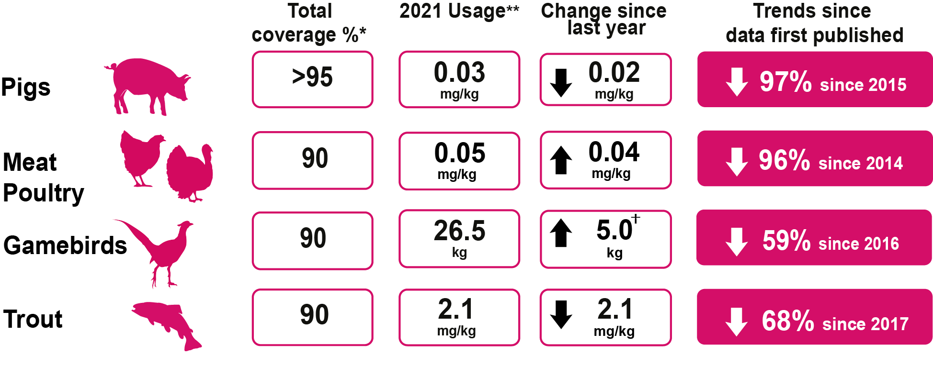
Antibiotic Usage Data
Antibiotic usage refers to the amount of antibiotics prescribed and/or administered per sector. The data have been collected and provided to the VMD by the animal industry on a voluntary basis
© 2022 VMD
* Represents the % animals covered by the data, except gamebirds which represents an estimate of the total % antibiotics sales
** mg/kg relates to the amount of active ingredient standardised by kg biomass and calculated using ESVAC methodology, % doses
refers to ‘actual daily bird-doses/100 bird-days at risk’
† Note that industry estimates suggest that, due to Covid restrictions, gamebird rearing reduced by 30% during 2020
Source: p. 9
VARSS REPORT 2021

Slide 13
Harmonised Monitoring of AMR
Resistance to non-HP-C I A s (A) and HP-C I A s (B) in Escherichia coli isolates from healthy pigs at slaughter. Interpreted using EUCAST ECOFFs unless otherwise indicated. Note scale differs between graphs.
(A) (B)
+++
Key
○ 2015
○ 2017
○ 2019
○ 2021
© 2022 VMD
+ Not tested
** Interpreted using an ESFA recommended ECOFF
AG: aminoglycosides, AP: amphenicols, BL: beta-lactams, ML: macrolides, PX: polymyxins, QU: quinolones, TC: tetracyclines, TS: trimethoprim/sulphonamides, 3/4GC: third and fourth generation cephalosporins
Source: Fig. 3.1; p. 65
VARSS REPORT 2021
13

Slide 14
Harmonised Monitoring of AMR
ESBL-/Amp C- and Carbapenemase producing Escherichia coli cultured on selective agars, from caecal samples from healthy pigs at slaughter in the UK.
© 2022 VMD
Source: Fig. 3.2; p. 67
VARSS REPORT 2021
14

Slide 15
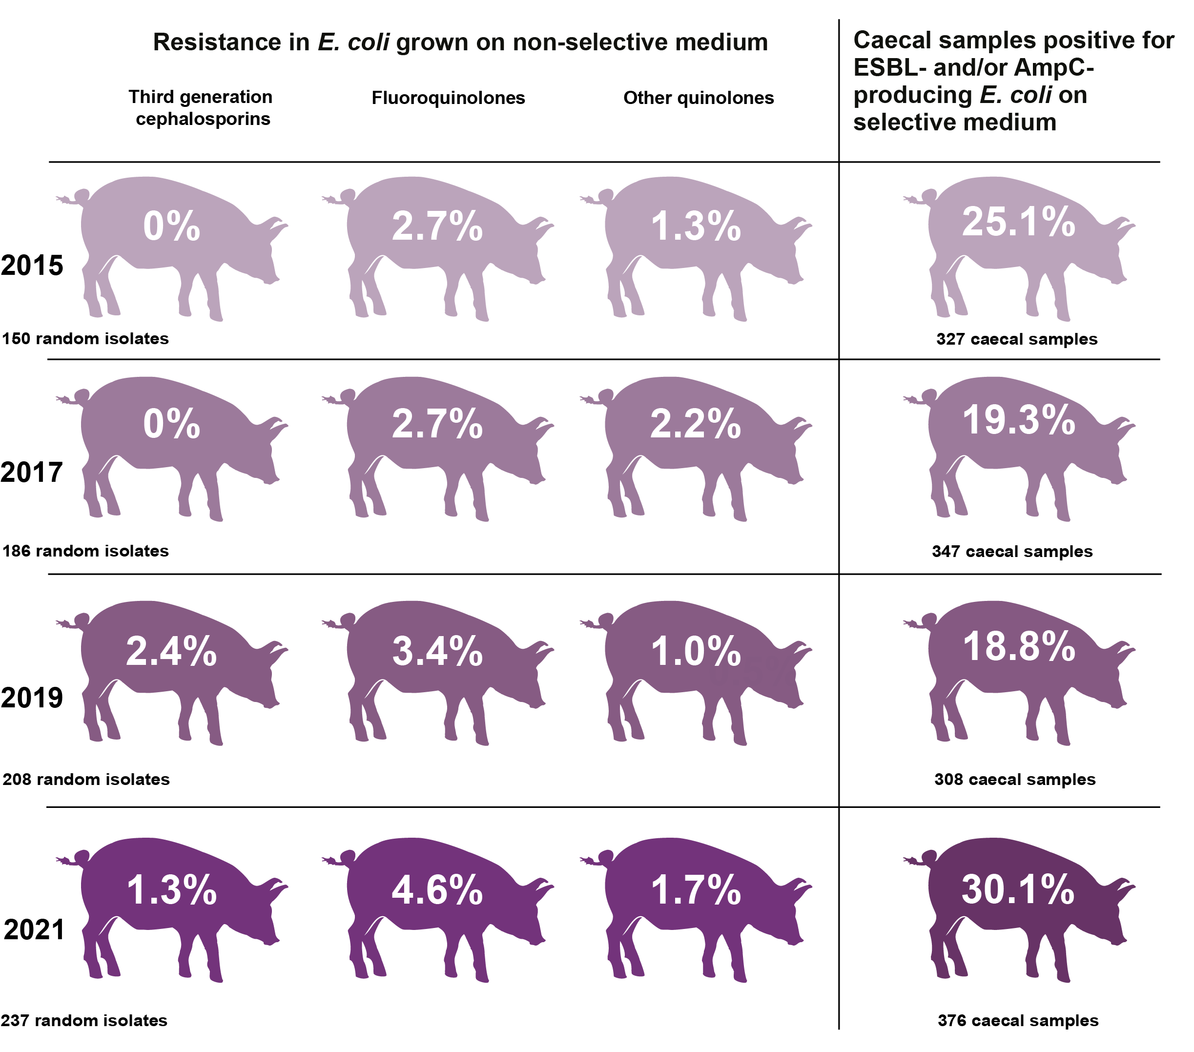
Harmonised Monitoring of AMR
Summary of resistance in E. coli from pigs
Source: p. 10
VARSS REPORT 2021

Slide 16
Harmonised Monitoring of AMR
Resistance to non-HP-C I A s (A) and HP-C I A s (B) in Salmonella isolates from healthy pigs at slaughter. Interpreted using EUCAST ECOFFs unless otherwise indicated. Note scale differs between graphs.
(A) (B)
Key
○ 2021
© 2022 VMD
* Interpreted using an EFSA recommended ECOFF
** Interpreted using EUCAST CBP
AG: aminoglycosides, AP: amphenicols, BL: beta-lactams, ML: macrolides, PX: polymyxins,
QU: quinolones, TC: tetracyclines, TS: trimethoprim/sulphonamides, 3/4GC: third and fourth generation cephalosporins
Source: Fig. 3.3; p. 69
VARSS REPORT 2021
16

Slide 17
Harmonised Monitoring of AMR
Key outcome indicators: proportion of harmonised monitoring Escherichia coli from broilers, fattening turkeys and fattening pigs, weighted by population size, averaged over two years. ESBL/AmpC results refer to caecal samples, all other indicators refer to isolates.
+
© 2022 VMD
Key:  2014/15  2015/16  2016/17  2017/18  2018/19  2019/20  2020/21
+ Data not available
Source: Fig. 3.4; p. 71
VARSS REPORT 2021

Slide 18
Clinical Surveillance of AMR
Resistance to non-HP-C I A s (A) and HP-C I A s (B) of Escherichia coli isolates from cattle, pigs, sheep, broilers and turkeys (all ages combined; n=199 to 1,262 in 2021). Note scale differs between graphs.
(A) (B)
Key
○ 2019
○ 2020
○ 2021
© 2022 VMD
AG: aminoglycoside, AP: amphenicols, BL: beta-lactams, QU: quinolones, TC: tetracyclines, TS: trimethoprim/sulphonamides, 3/4GC: third and fourth generation cephalosporins
Source: Fig. 4.9; p. 94
VARSS REPORT 2021

Slide 19
Clinical Surveillance of AMR
Antibiotic susceptibility in Salmonella spp. isolated from different sources, 2019 to 2021 (n=4,507 in 2021).
© 2022 VMD
Key:  2019  2020  2021
* Ducks, horses, other non-avian species, other avian species and farm environment.
Source: Fig. 4.21; p. 107
VARSS REPORT 2021

